Slide 1


Loan Management System
Borrow Quick and Pay Quick
Group 6
Akhil Reddy Motakatla Prathyusha Papagari
Nikhitha Siddireddy Gari Sri Nithya Gobburi
Pardhasaradhi Reddy Katta Daneesh Gali
Pooja Vadlakonda Balakrishna Daddali

Slide 2


Agenda
01
Project Description
04
UI Interfaces
A concise summary of the project, highlighting its purpose, goals, and objectives.
Perspectives or representations of project data tailored for specific stakeholders understanding and needs.
02
ER Diagram
05
Source Code
Visual map showing relationships between data entities in databases.
Code containing instructions and logic, forming the foundation of software development projects.
03
Technology Used
06
Reference
Technology used in a project refers to specific tools, systems, software, or hardware utilized to achieve project goals efficiently and effectively.
Sources cited for information within the project development or research

Slide 3

Project Description
Handling loan applications, approvals, disbursements, and repayment tracking are all made easier and more automated with the help of the Loan Management System (LMS).
This system seeks to improve a financial institution's management of different loan kinds in terms of accuracy, efficiency, and transparency.

Slide 4
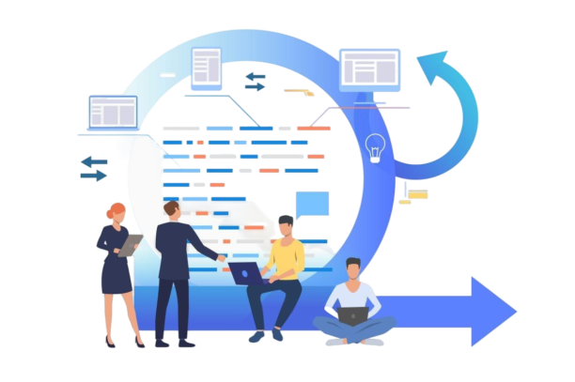
Project Description
The main clients of the Loan Management System are external clients looking for different loan products and internal employees in charge of loan operations.
It ensures a smooth and well-organized approach to the loan lifecycle by covering a variety of loan kinds, including business loans, mortgages, personal loans, and more.

Slide 5
Project Features
User Authentication: Safe login for loan officers and applicants.
User Registration: Applicants can register their account in the system in order to apply loan.
Loan Application: Applicants can easily submit loan requests with the required documentation using an intuitive interface.
Insurances: Applicants can add all their insurance policies in the system.
User Profile: Applicants can Update their profile once they are logged in.
Plans: Users can view some list of plans in order to apply the loan

Slide 6

Project Features
Support: Applicants can submit support request if they have any queries.
Payment Schedule: Applicants can see Payment Schedule for their applied loans.
Transactions: Applicants can see all the transactions they have made.
Loan Status: Users can check the status of their applied Loan
Application Review: A system that automatically evaluates applications, does credit checks, and makes choices for loan officers.
Admin: They can review the loan and give comments

Slide 7
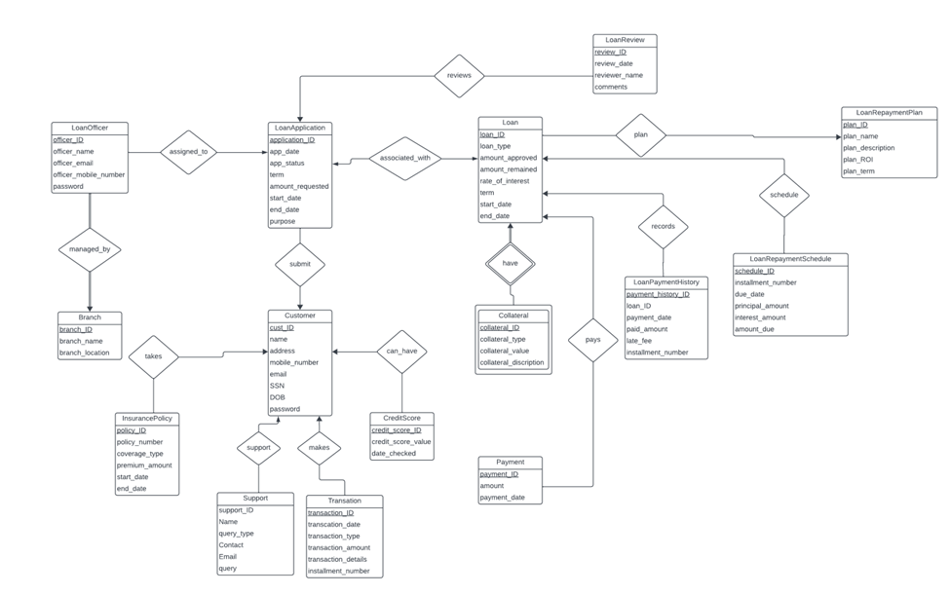
ER Diagram

Slide 8

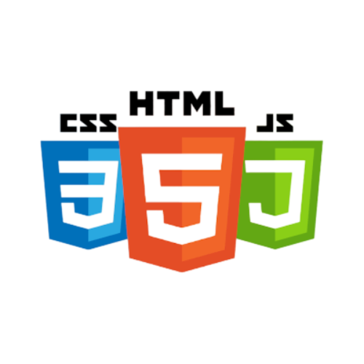


Technology Used
Technologies/Frameworks
NodeJS
ReactJS
MongoDB
JavaScript
HTML
CSS
ExpressJS
Tools
Visual Studio Code
MongoDB Compass

Slide 9
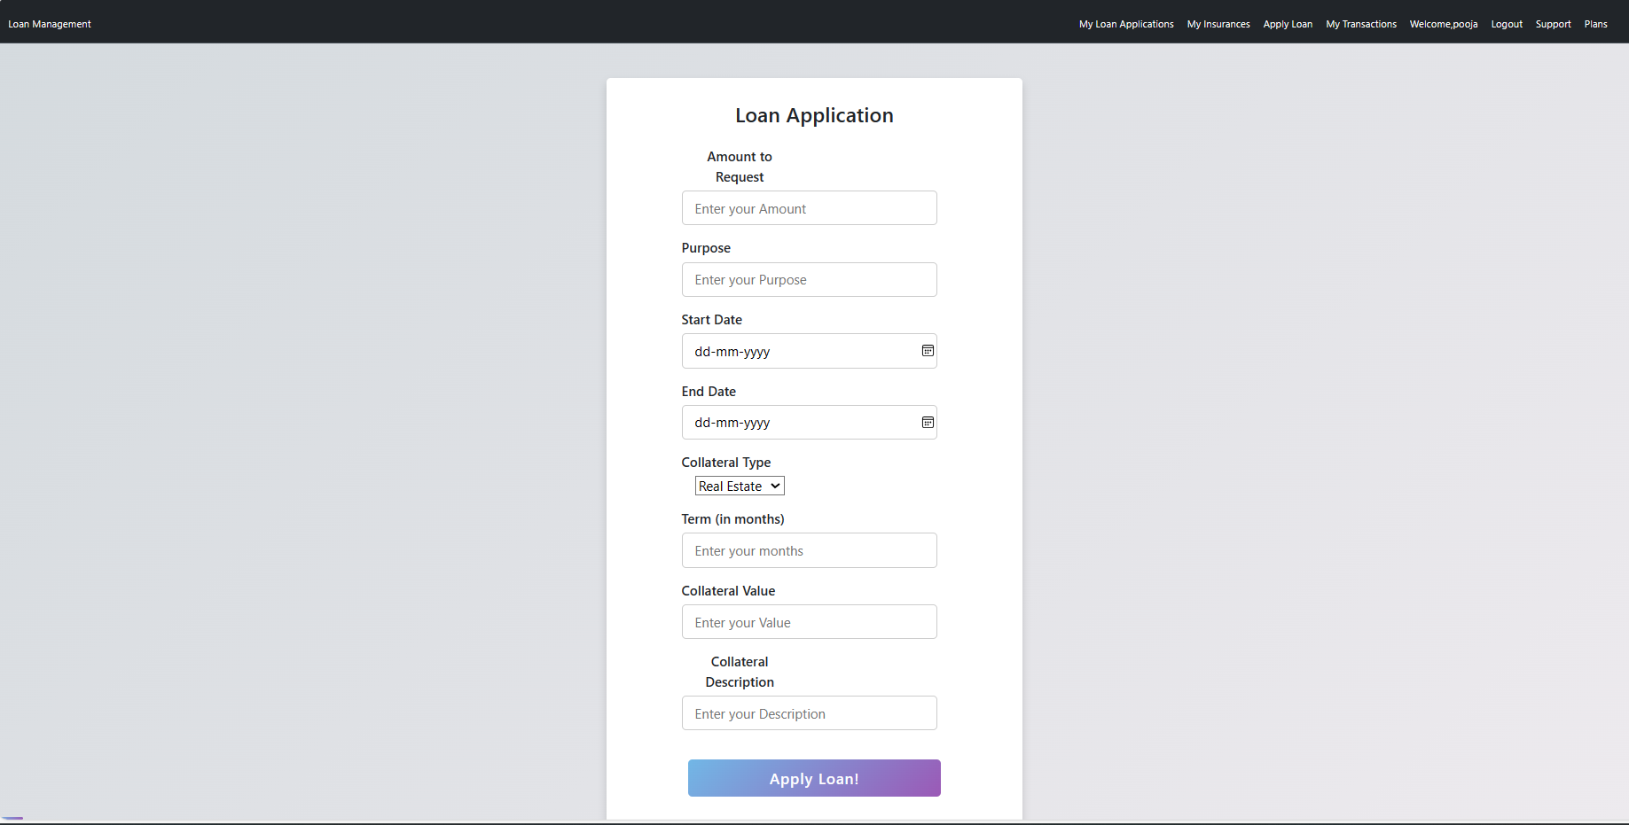
UI Interfaces

Slide 10
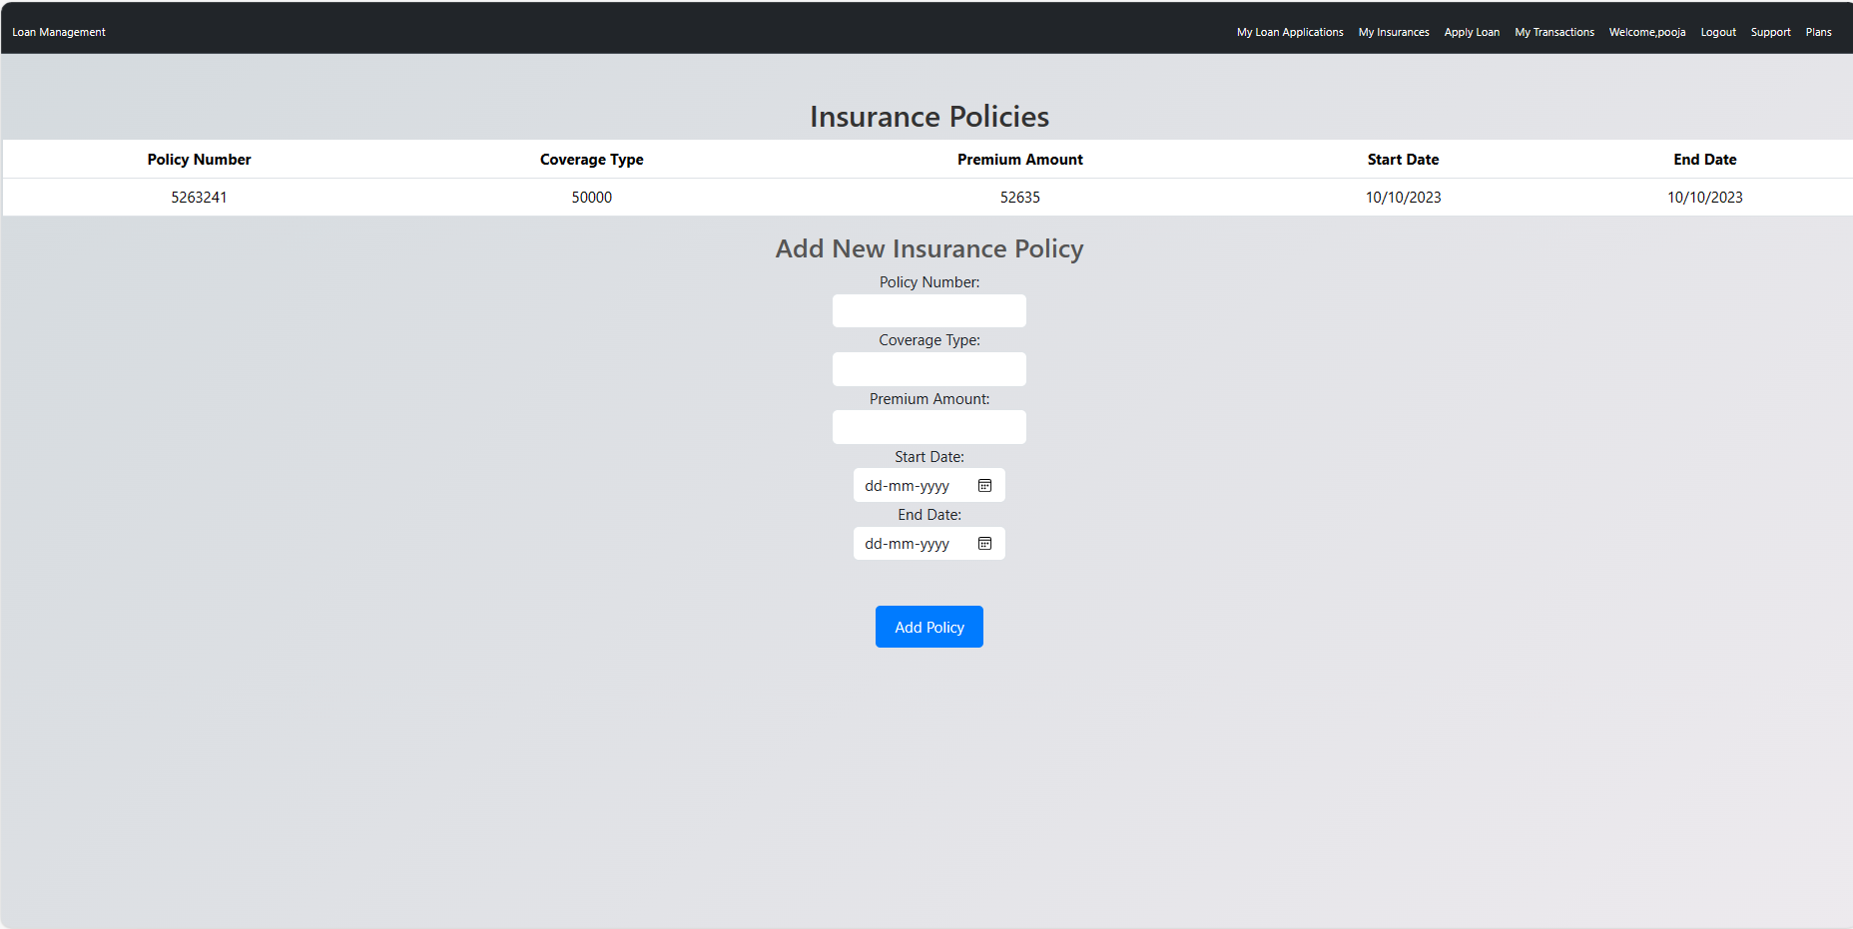
UI Interfaces

Slide 11
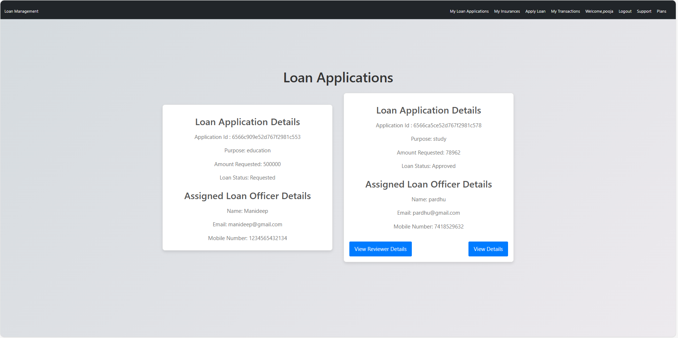
UI Interfaces

Slide 12
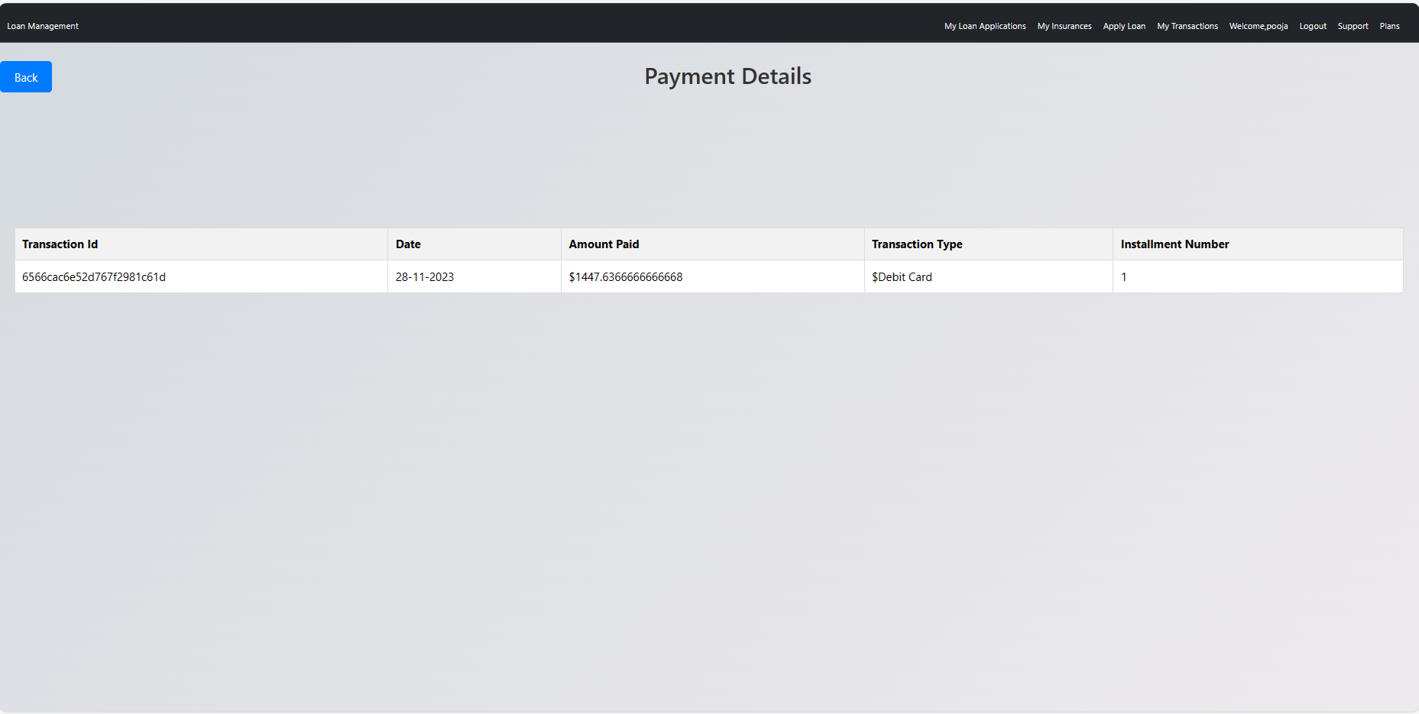
UI Interfaces

Slide 13
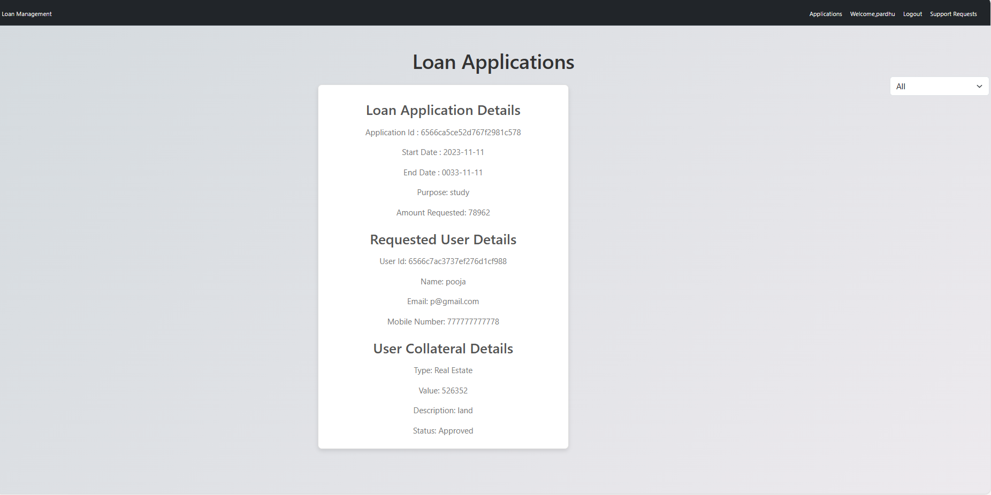
UI Interfaces

Slide 14
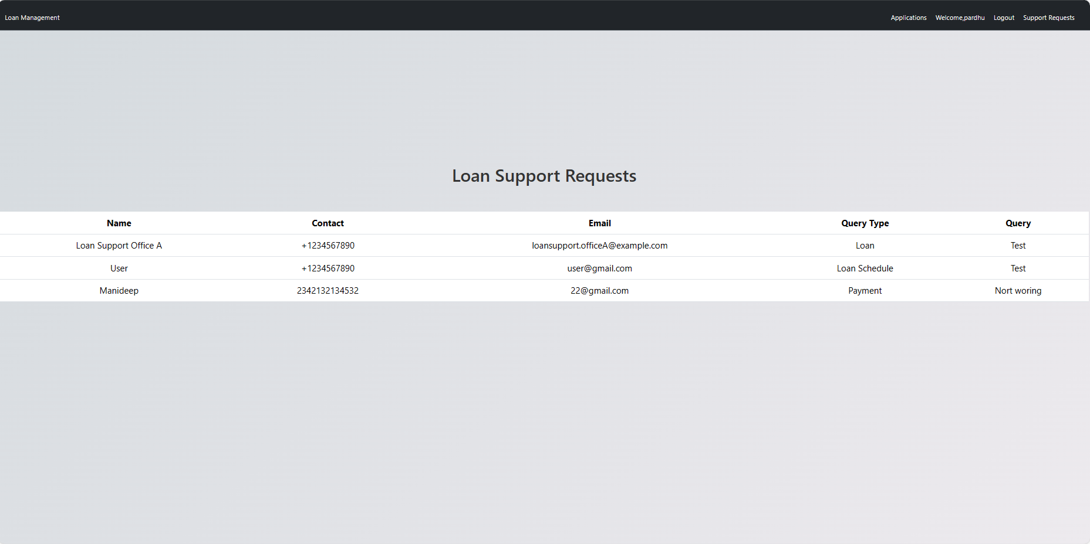
UI Interfaces

Slide 15
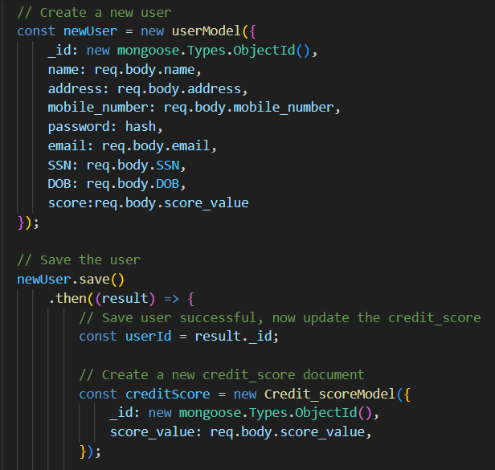
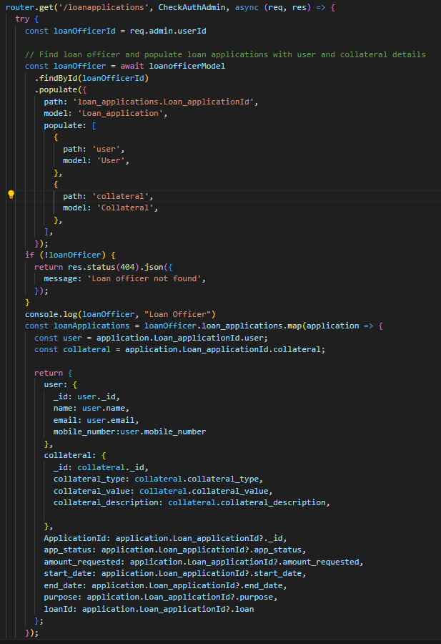
Source Code

Slide 16
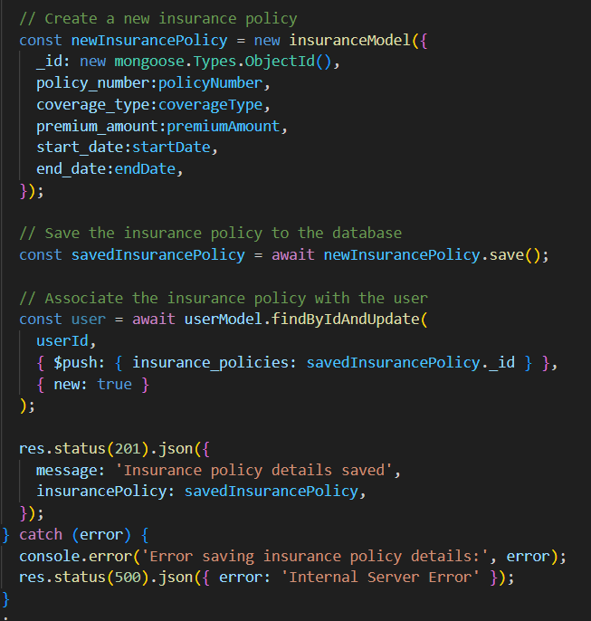
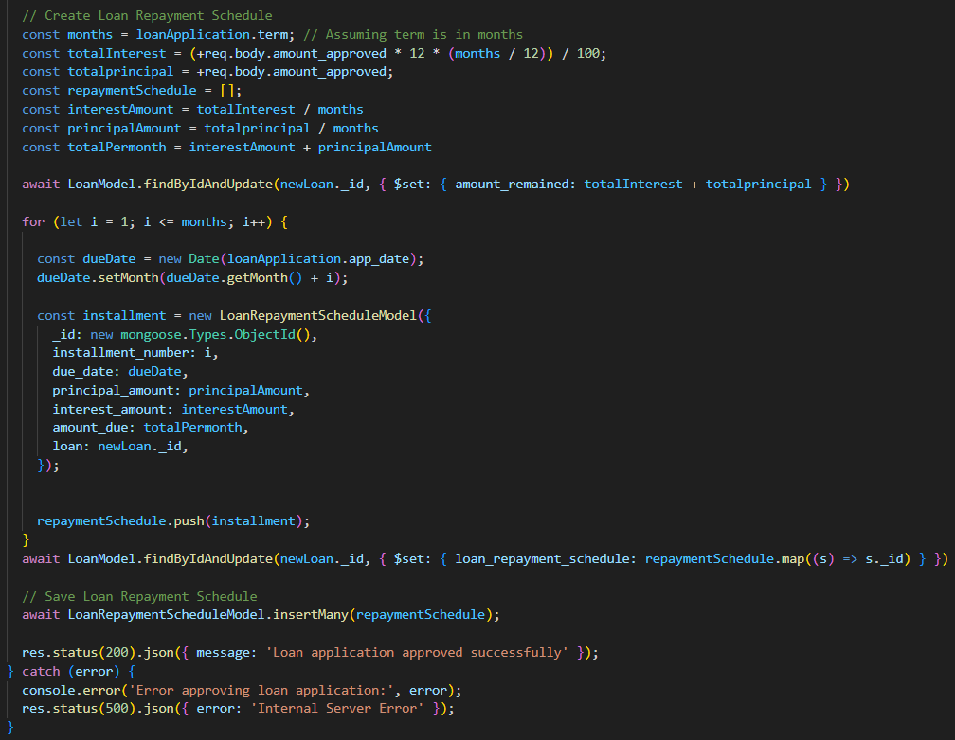
Source Code

Slide 17
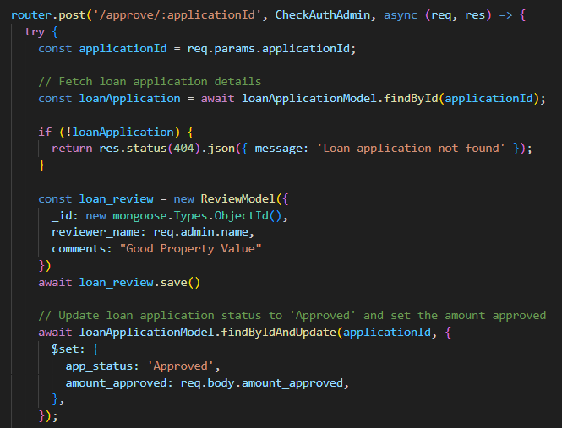
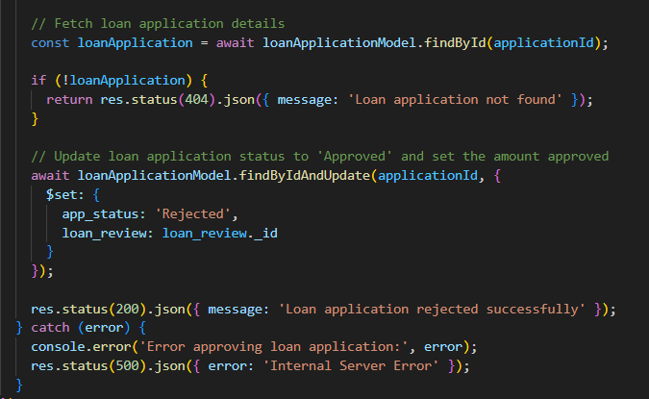
Source Code

Slide 18

Project Demo

Slide 19

References
https://www.w3schools.com/REACT/DEFAULT.ASP
https://www.w3schools.com/bootstrap/bootstrap_ver.asp
https://www.w3schools.com/js/default.asp
https://www.w3schools.com/js/default.asp
https://www.w3schools.com/html/default.asp
https://www.w3schools.com/nodejs/default.asp
https://www.w3schools.com/mongodb/index.php
https://www.w3schools.com/typescript/index.php

Slide 20
THANK YOU!
ANY QUESTIONS?

